Slide 1
Leaving volunteering:
Personal experience & management challenge
Bruce Davenport
Notes:
`1234567890-=qwertyuiop[]asdfghjkl;’#\zxcvbnm,./
¬!”£$%^&*()_+QWERTYUIOP{}ASDFGHJKL:@~|ZXCVBNM<>?

Slide 2

The prompt…
Leaving volunteering due to age-related issues
“Erm... Well there’s another thing as well, erm, I’m a member of the <British conservation organisation 1> ((Clears throat)) and until three days ago, erm, ((Clears throat)) I’d been with the <British conservation organisation 1> for five or six years, erm, and used to go, erm, every Sunday to, to act as a room, room guide there. And I literally packed up last weekend. Erm, so I, I, I can’t go there anymore so I have to find something else to do on Sun- on a Sunday now. ((Laughter))”
13 times in 1 interview

Slide 3
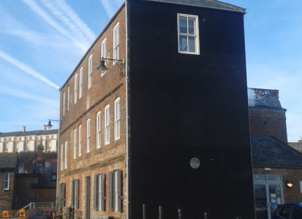
… which begged some questions
Leaving volunteering due to age-related issues
We talk about volunteering
  In terms of politics and economic necessity
  In terms of managing volunteers
  In terms of health & wellbeing outcomes for volunteers
Do we ever ask:
  What is it like when you have to stop?
  What does stopping do for your wellbeing?
  What is it like when you are managing someone in this position?

Slide 4
What we did
Leaving volunteering due to age-related issues
Semi-structured interviews focusing on volunteers’ experiences & managers’ experiences;
Analysed the data drawing on what people and theoretical categories.
Who we worked with
 |  | 3 cultural heritage organisations
 |  | 5 volunteer managers |  |  |  |  | 5 current volunteers |  |  |  |  | 5 ex-volunteers
7 volunteer managers |  |  |  |  |  |  | 5 current volunteers |  |  |  |  | 7 current volunteers with experience of withdrawal |  |  |  |  |  |  | 2 ex-vol’rs
Who we intended to interview
Who we interviewed
This was an unanticipated (& relevant) aspect of volunteer experience

Slide 5
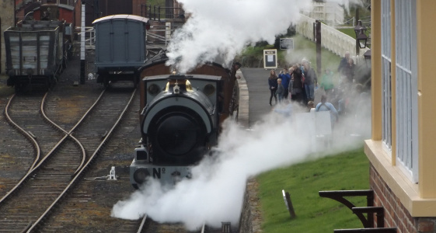
What we did
Leaving volunteering due to age-related issues
Working through a series of comparisons:
  Volunteers’ perceptions of the impact of volunteering cf literature on volunteering & wellbeing
  Volunteers’ anticipation of impact of leaving cf their own perceptions of the impact of volunteering
  Volunteers’ experiences of leaving cf their anticipations

Slide 6
Impacts of volunteering related to wellbeing
Leaving volunteering due to age-related issues
Nature of impact
Affective responses
Giving back-helping-sharing
Friendship or social relationships
Learning
Negative impacts
Respite
These fit well with literature on wellbeing
This includes both emotional and health impacts
This is not so prominent in the literature but fits with unpublished findings from earlier work.

Slide 7
Anticipating leaving
Leaving volunteering due to age-related issues
Nature of impact
Affective responses
Giving back-helping-sharing
Friendship or social relationships
Learning
Negative impacts
Respite
Anticipating leaving
Negative affect
Loss of benefits*
Relates to wider context
Resisting stopping
Self-aware hopefully
End gradually
I do it to suit me
How people responded to the question
Forms of personal agency
A different perspective

Slide 8
Experiencing leaving
Leaving volunteering due to age-related issues
Experiences of stopping
Negative affect
Wanting to return
Relates to a wider context
Loss of benefits*
Resisting stopping
Letting people down
Pain
Deciding to stop
Comfortable with decision
Achieving closure
Ending gradually
Second retirement
Thrust on us
Out of the habit
Anticipating leaving
Negative affect
Loss of benefits*
Relates to wider context
Resisting stopping
Self-aware hopefully
End gradually
I do it to suit me

Slide 9
Experiencing leaving
Leaving volunteering due to age-related issues
An analogy with retirement?
Work on retirement decisions has shown that people exercise agency in their retirement report higher life satisfaction afterwards (Hershey & Henkens, 2013).
Could the same apply to ‘retirement’ from volunteering?
Experiences of stopping
Resisting stopping
Deciding to stop
Comfortable with decision
Achieving closure
Ending gradually
Forms of personal agency

Slide 10
Managing people out of volunteering
Leaving volunteering due to age-related issues
A sequence of themes
  Relationships between staff and volunteers
    balancing closeness with professionalism
  Organisational reciprocity
    a perceived, moral reciprocity towards the volunteers
  Policies and values
    create frameworks and provides confidence but leave space for managers
  Going beyond the bounds
    emerges out of the preceding – going beyond what the rules require
  Limits
    not predefined but encountered and rationalised
  Emotional impact on staff
    as a consequence of the preceding.

Slide 11
Conclusions (1): For volunteers
Leaving volunteering due to age-related issues
Leaving volunteering in later life is (more-or-less) inevitable;
Participants anticipate/experience leaving volunteering as a form of loss;
This has the potential for further, longer-term impacts post-volunteering;
There are possibilities for personal agency which may ameliorate these impacts.
This leaves open the question of whether this is an issue that a host organisation bears a moral responsibility for?

Slide 12
Conclusions (2): For volunteer coordinators
Leaving volunteering due to age-related issues
The policies and relationships create space for freedom for managers to act in ways that support that agency & process of leaving;
Staff go beyond what is required to support volunteers but the limits of this are ill-defined;
Organisations and volunteers may benefit if these processes and limits are articulated.
In subsequent dissemination work, volunteer coordinators
identified these issues in their own experience
expressed a need for (greater) support.

Slide 13
Starting in January 2024…
Cessation of Volunteering (ESRC project)
8 case study cultural heritage organisations:
  England and Scotland
  Museums, galleries, heritage & religious organisations
  Large nationals to tiny local sites
  Large staff corps to fully volunteer-run
Interviews with :
  Volunteers
      Ex-volunteers
  Staff
National survey of volunteer managers across all volunteer-involving sectors
Reflective conversations with partners leading to creation of ‘repertoire of possible responses’ for volunteer managers.
Advice for volunteers.
bruce.davenport@newcastle.ac.uk

Slide 14
Whilst I’m here…
Post-lockdown volunteering
Just started a small project looking at volunteering in heritage organisations post-lockdown.
UK and other countries seeing a long-term decline in formal volunteering.
Some organisations report difficulties in recruiting post-lockdown
Interested in people who have not returned to volunteering since lockdown
Many reasons why this might be. Best available data doesn’t help much.
Would like to survey people who have not returned to volunteering since lockdown.
To do that, I have to work with volunteer co-ordinators in heritage organisations.
If you know a volunteer coordinator at a heritage organisation in the UK, please let me know.

Slide 15
Any questions?
Cessation of Volunteering

